Slide 1
CS 498
Virtual Reality
Production & Design Processes
(For internal use only)
Set 5

Slide 2
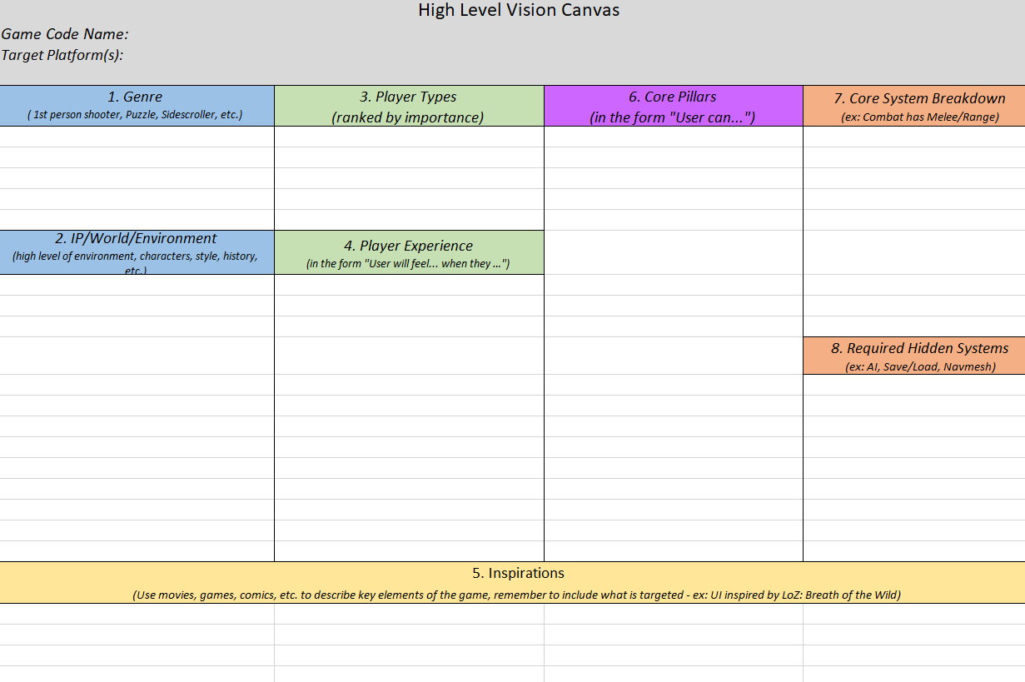
Now that you have your vision, what next
Review the features and systems that support them
Core Pillars (features)
Core Gameplay Systems
Hidden Systems
These become your feature list

Slide 3
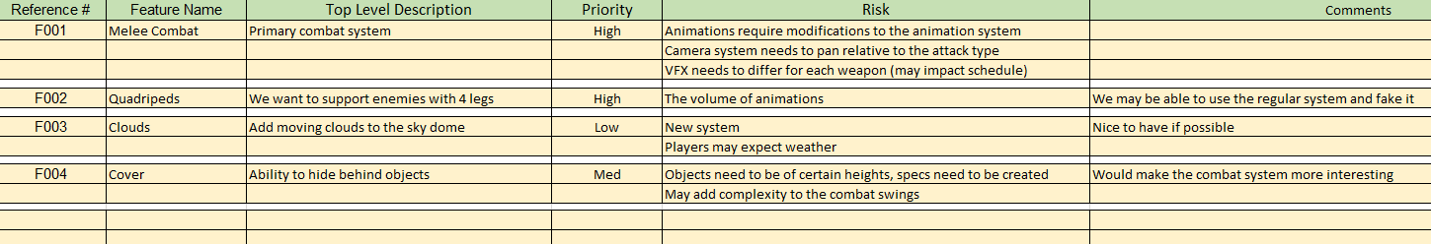
Simple Feature List

Slide 4
Technical Design Document: Built from the Feature List
Breaks down the Feature List into technically appropriate segments
Specifics will be programming elements
Systems (combinations of related tasks/features)
One-off features
Clarifies the priorities, risks and dependencies

Slide 5
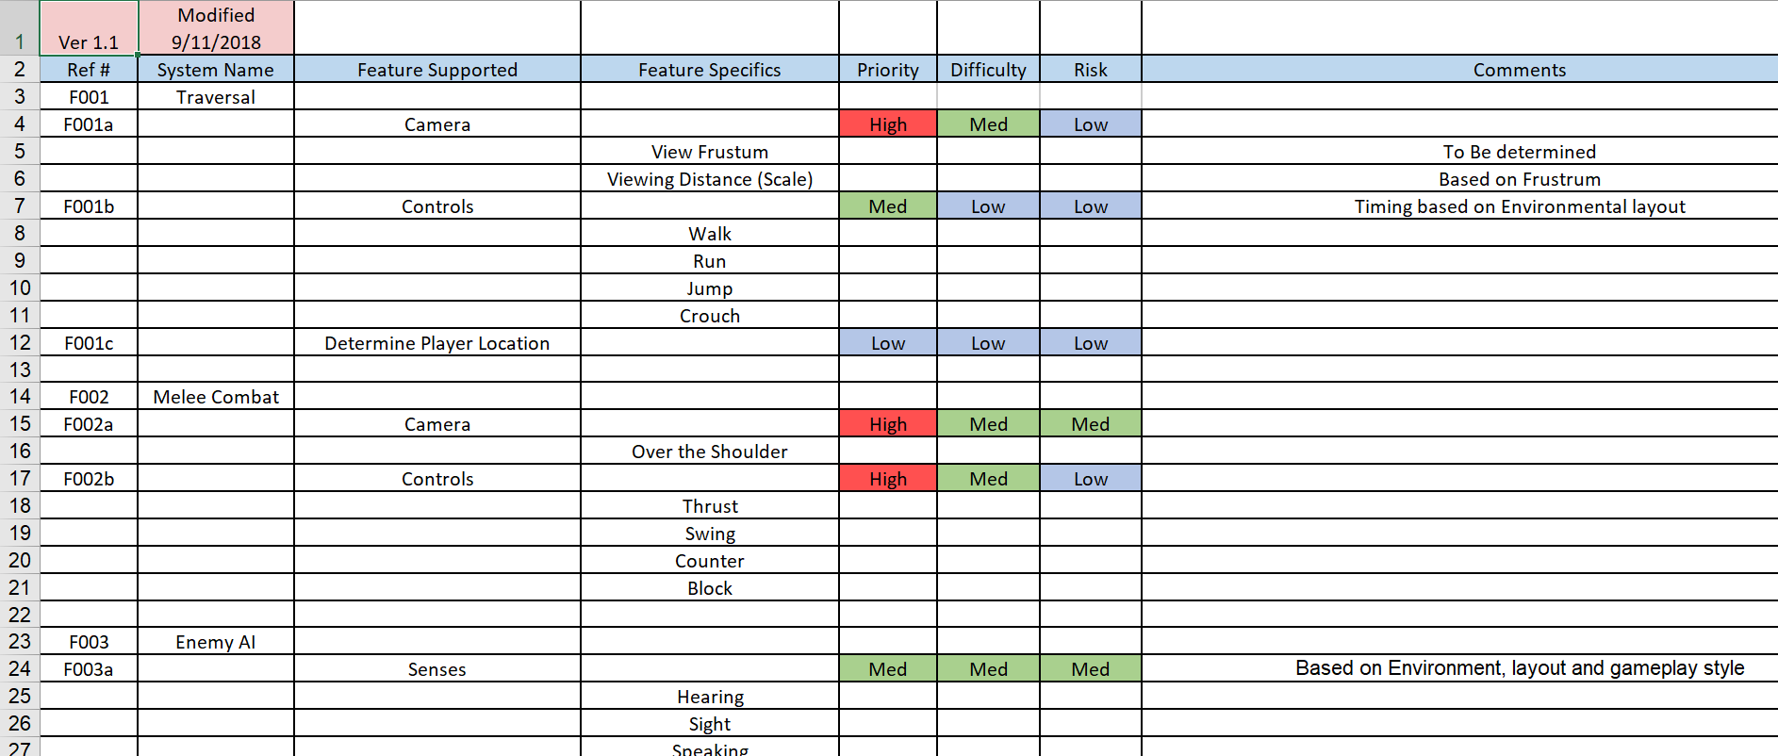

Slide 6
Milestone Plan for each phase
Weekly or Bi-weekly set of tasks to be done by the team
Tracked to:
Show progress
Expose scope issues
Determine risks
Ensure that the correct dependencies are being considered

Slide 7
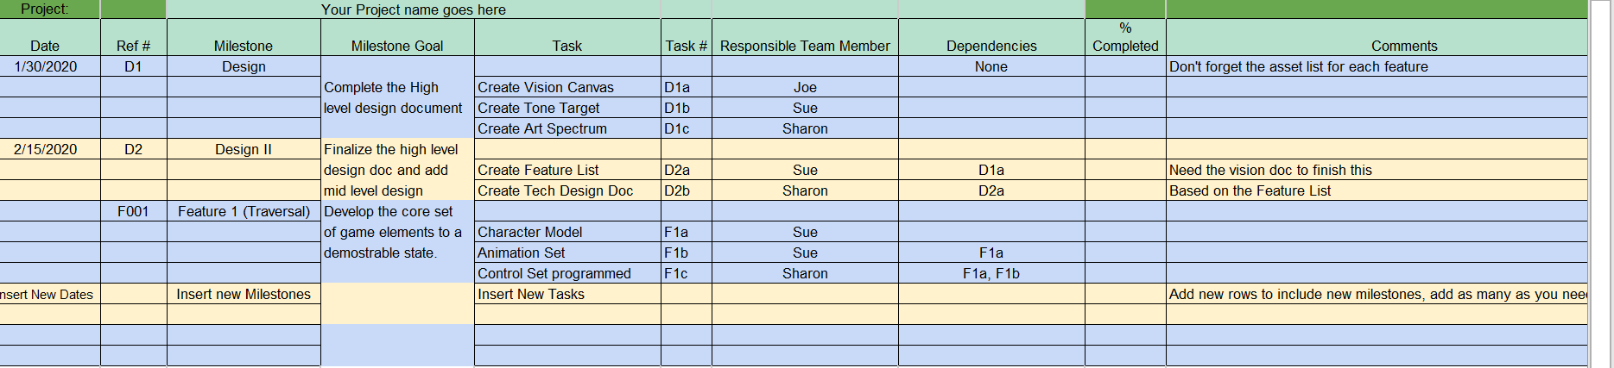
Simplified Project Plan

Slide 8
Asset List
Details out the assets needed by each task and all milestones

Slide 9
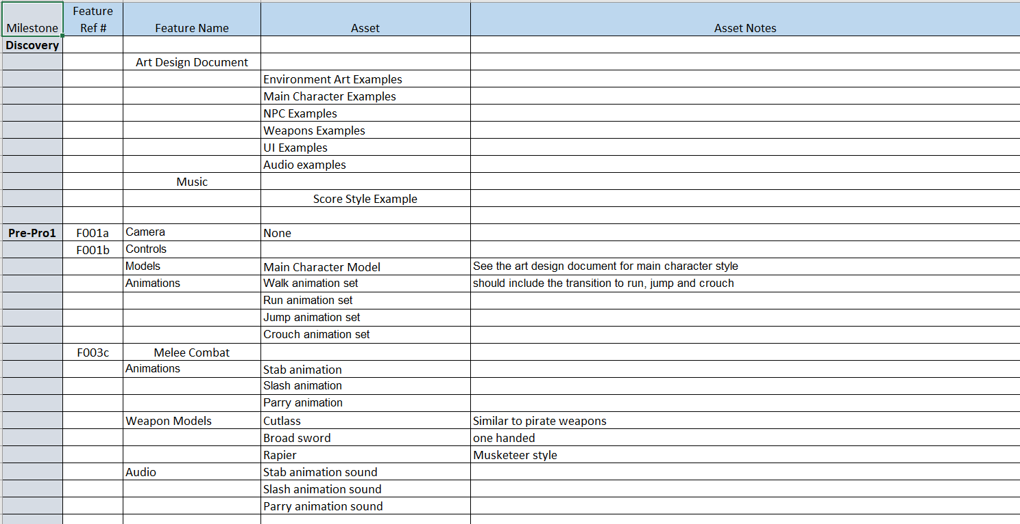

Slide 10
Quality Assurance (QA) Test Plan
Details out the elements of each feature to ensure it is working properly
As you complete each pre-pro milestone and Alpha the test plan becomes key
Have someone not on the team, run through the test plan
Remember to test integration, where system interact and work together
Most often failures occur here

Slide 11
QA Test Plan |  | Project:_____________________________
Date | Build # | Tester Name
1/14/2019
Test # | Unit/Feature | Item to be Tested | Success/Fail
1 | Main Screen
1a |  | Game Loads properly to Main Screen
1b |  | UI elements change focus correctly
1c |  | Choosing <Start Game> functions correctly by placing the player in the game at the beginning of the first element
1d |  | Choosing <Exit Game> functions correctly closing out the game cleanly and places the player back in the platform interface
1e |  | Choosing <Load Saved Game> functions correctly takes the player to the <Save/Load Game system
1f |  | Choosing <Settings> functions correctly by taking you to the Player Setting System
2 | Performance
2a |  | Game loading time is within spec (loads within XX seconds)
2b |  | General game play shows no hitching or graphic errors
3 | Save Game
3a |  | Game save time is within spec (saves within XX seconds)
3b |  | Saved Game can be reloaded immediately
3c |  | Saved Game Data is correct on reloading

Slide 12
User Interactions in VR Yasser Malaika (Valve)
Common Interactions are: Object interactions, system commands & navigation
VR related terminology for input devices Maps to
6 DOF (Degrees of Freedom): Within Reach
Pointing Reach & beyond
Hand Control Activation elements (buttons, swiping etc.)
Ambient Invocation: things like voice Indirect & infrequent
Subconscious (your location in space, direction, rotation, etc.) Background
Affordance: aspect of an object that hints at function
Abstract affordances are important in User Comfort
In a person’s mind abstract affordances will lose out to concrete affordances
The more real the look of an affordance the higher the user expectations
If a gesture has meaning it can override the kinematic issues

Slide 13
User Interactions
The ideal interaction set
https://www.youtube.com/watch?v=FheQe8rflWQ&t=43s
The goal:
Natural & intuitive, gesture driven interactions
Current state of interactions
https://www.youtube.com/watch?v=65u3W7wjXs0
The reality:
Limited input devices, limited range of motion, limited FOV, 2D interfaces in 3D
Another example: https://www.youtube.com/watch?v=FOTGv2WxhXQ&feature=emb_logo

Slide 14
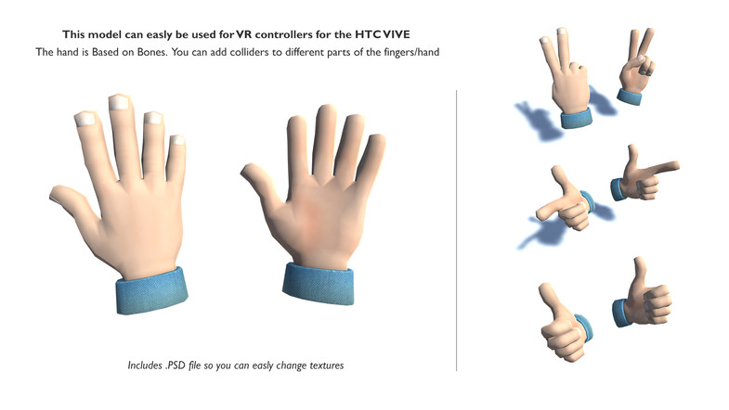

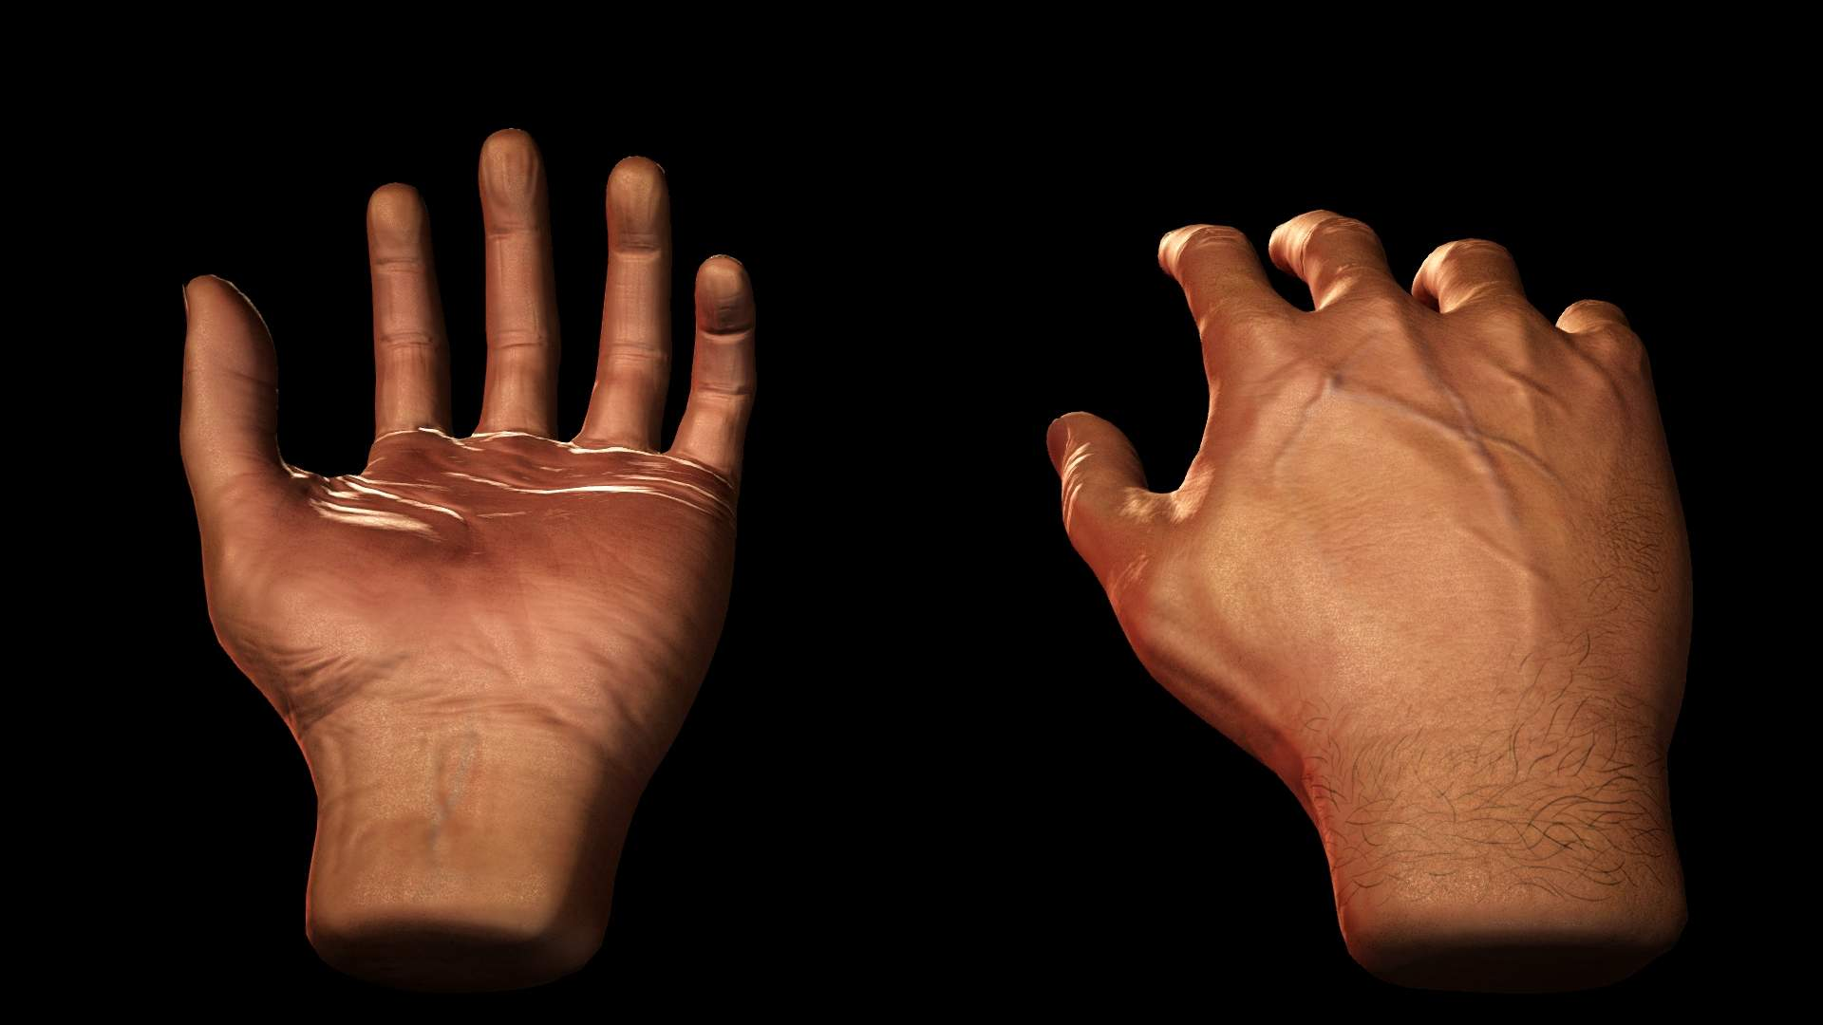
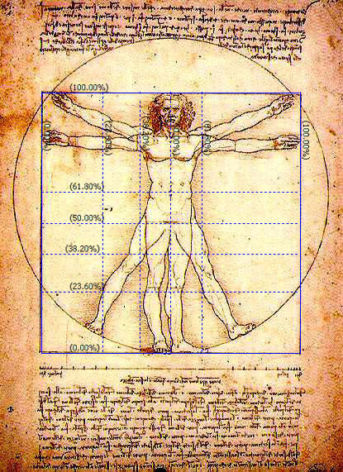
Object Interactions: Selection Yasser Malaika (Valve)
VR input systems map naturally to the human form
Visual (looking around) maps to the head
Movement maps to the legs
Selection/input maps to the arms/hands
Uncanny Valley: When things appear human but not quite, it creates a revulsion in the person.
In VR it actually applies to yourself
Hands are the best example of this
Don ‘t mix them up
Don’t use hands for movement
Head pointing/gaze for selection can be problematic
There are exceptions, teleportation for example
Technology is improving here
Unity Asset store
Renderhub.com

Slide 15
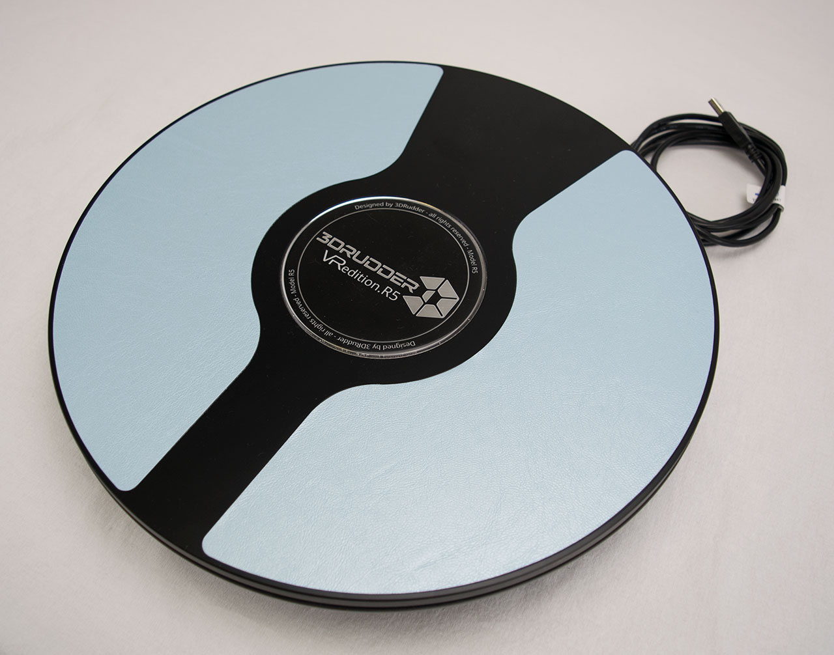
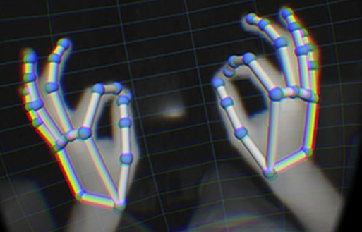
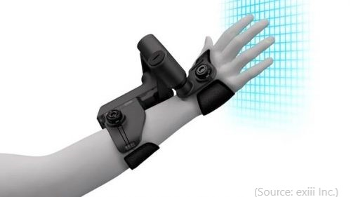
User Intent: How do we get their Input and give Feedback Yasser Malaika (Valve)
Input devices are fairly consistent through the Vive, Rift/Quest and PSVR
They offer 6 degrees of freedom and excellent 1 to 1 position tracking
Give developers advantages
Able to target multiple platforms
Set conventions that will develop into standards
Allows the development cultural to borrow from each other quickly
There are a multitude of other devices out there
Hand tracking
Haptic feedback via gloves, and other wearables
Foot devices
Voice command systems
Leap motion
3d rudder.com

Slide 16
Object Interaction: Considerations when using the hands as input devices Leapmotion.com: design best practices
Interactive elements should be scaled to the expected interaction (e.g. full hand or finger/pointer size).
One finger/pointer targets should be no smaller than 20 mm in real-world size.
This ensures the user can accurately hit the target without accidentally triggering targets next to it.
Keep in mind that human hands naturally move in arcs, rather than straight lines.
Limit the number of gestures that users are required to learn.
All interactions should have a distinct initiation and completion state.
Ensure that users can interact with objects occluded by their hands.

Slide 17
Object Interactions: Selection methodologies
Arm Extension Selection
Go Go Technique
Non-linear mapping between physical and virtual hand position
Local and distant regions (linear < D, non-linear > D)
KFC
Poupyrev, I., Billinghurst, M., Weghorst, S., & Ichikawa, T. (1996). The Go-Go Interaction
Technique: Non-linear Mapping for Direct Manipulation in VR. Proceedings of the
ACM Symposium on User Interface Software and Technology, 79-80.
© 2017 Elsevier Ltd. All rights reserved.

Slide 18
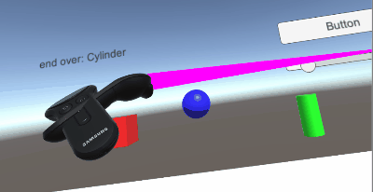
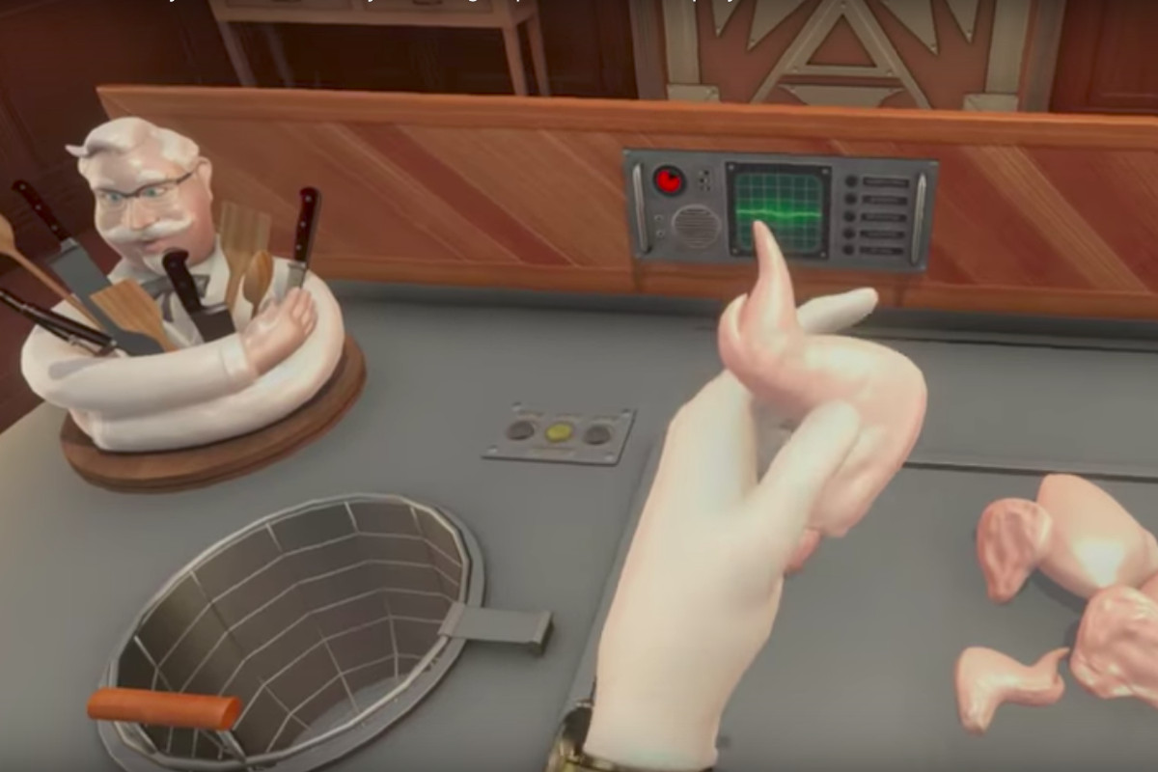
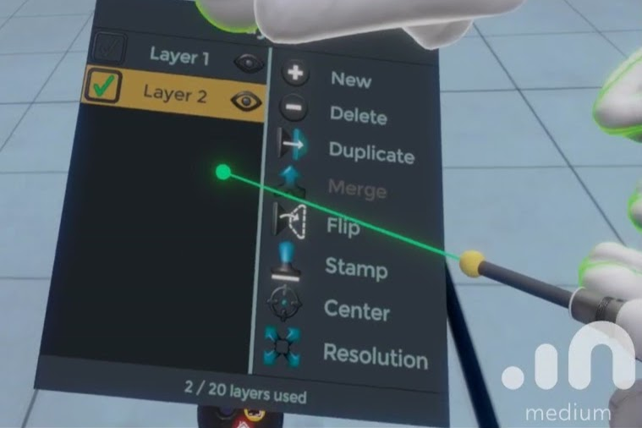
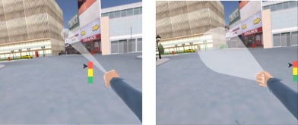
Object Interactions: Selection methodologies
Touching
Within reach (Local zone)
Hands are naturally mapped
You can also use a local pointer
Occlusion
Pretty much your standard 2D menu
Ray Cast (Mid/long range pointing)
Accurate method to choose
Paper Beast https://www.youtube.com/watch?v=R_lCEC30H3A
Variants include
Cone casting
Snap to (for teleportation)
Oculus developer forums
KFC
© 2017 Elsevier Ltd. All rights reserved.

Slide 19
Object Interactions: Selection Feedback
Feedback methods for selection available
Graphical Change
Voice
Color Change
Feedback method for selection made
Audio
Voice
Color Change
Graphic Change
Oculus developer forums

Slide 20
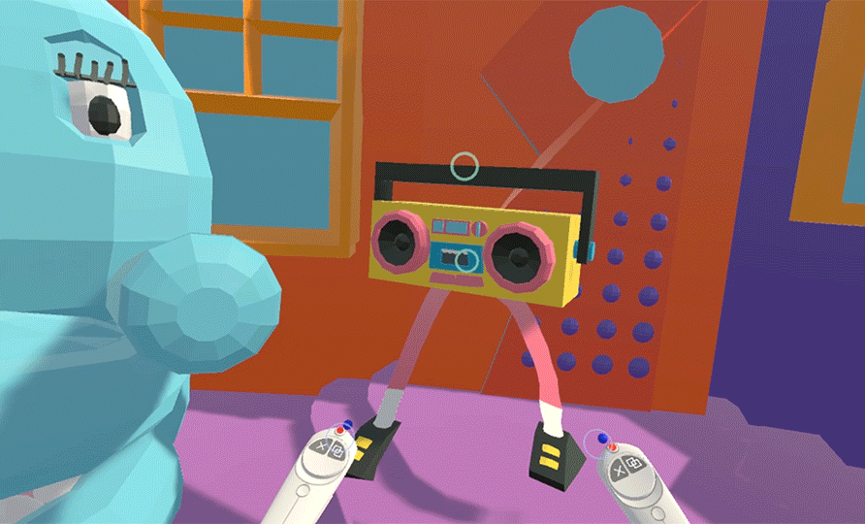
Object Interactions: Manipulation
Manipulations, change:
Attachments
Position
Rotation
Size
Examples: https://www.forrestthewoods.com/blog/the_vr_interface_of_dino_frontier/
Vrscout.com

Slide 21
VR Design Specifics: Examples
Hands & local interactions (reaching out to grab and touch):
Oculus’ Lone Echo’s 2: 1:40 https://www.youtube.com/watch?v=O6zlrKhNSM4
1:
Affordances:
Job Simulator: Gourmet Chef https://www.youtube.com/watch?v=qZX_WVhL3eg
KFC Job Training: 2:00 https://www.youtube.com/watch?v=LritONRSiXc

Slide 22
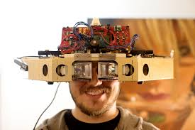
Augmented Reality Experiences and their Interactions
Window on the World (seen through a phone or tablet)
Passive
Adding elements to a photo
Active
Overlaying elements to the real world
Marker Driven
Non-Maker Driven
Immersive AR (seen through glasses or HMD)
Overlaid elements become part of the user’s reality
Copyright Magic Leap: Prototype Headset

Slide 23
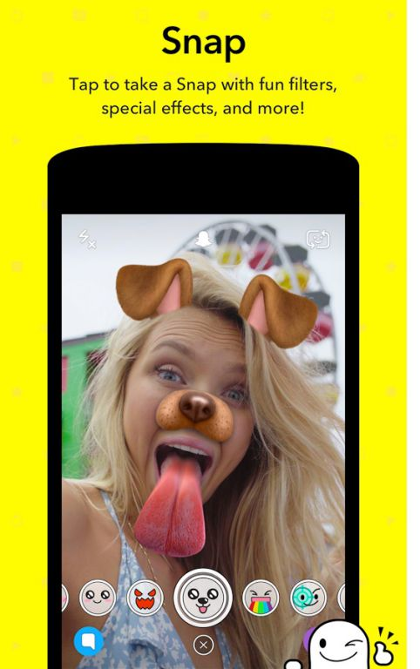
Augmented Reality UI: Passive WoW
Audience is likely mass market
UI should be very simple
Standard UI methods
Buttons
Swipes
Copyright Snap Inc.

Slide 24
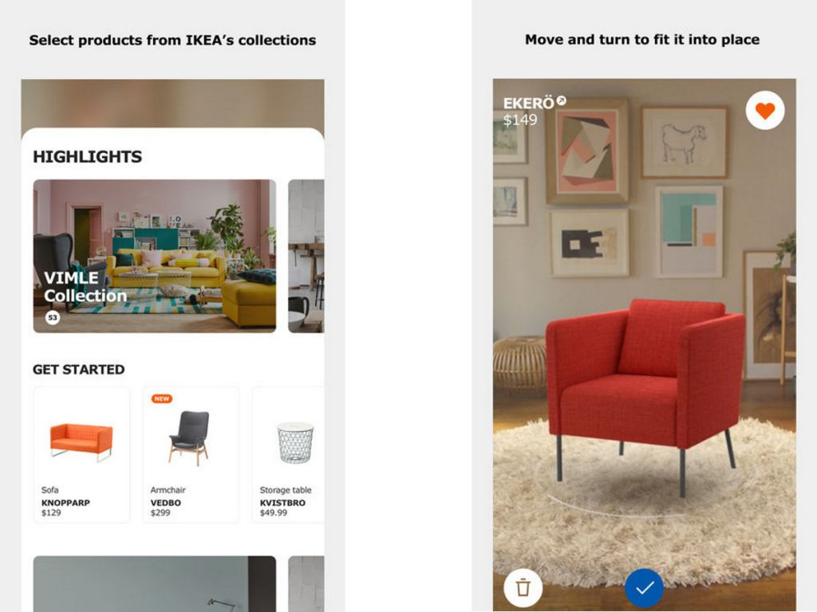
Augmented Reality UI: Active WoW
Audience is likely mass market
UI still needs to be very simple
Hide most of it, offer access to higher end users
Markers and surfaces
Consideration for space and marker placement
Standard UI methods
Buttons
Swipes
Consideration for Error Detection
Google’s path (Glasses to Lenses)
Copyright IKEA

Slide 25
Augmented Reality UI: Immersive
Very interesting opportunities
Interface options are like VR
Hardware makes a difference
Hand and/or Eye Tracking
Interface via device
Tilt Five https://www.kickstarter.com/projects/tiltfive/holographic-tabletop-gaming
Interface via visual/auditory feedback
Hololens 2 https://www.cnet.com/videos/watch-microsoft-demo-hololens-2-at-mwc/
3.55
Real World Tactile Feedback
MR – interacting with an overlay of the real world
https://www.youtube.com/watch?time_continue=10&v=sv6T-tg6RL4&feature=emb_logo

